Slide 1
Classification Modeling
Ensemble Methods

Slide 2
Rationale
In any application, we can use several learning algorithms; hyper parameters affect the final learner
The No Free Lunch Theorem: no single learning algorithm in any domains always induces the most accurate learner
Try many and choose the one with the best cross-validation results

Slide 3
Rationale
On the other hand …
Each learning model comes with a set of assumption and thus bias
Learning is an ill-posed problem (finite data): each model converges to a different solution and fails under different circumstances
Why do not we combine multiple learners intelligently, which may lead to improved results?

Slide 4
Rationale
Why it works?
Suppose there are 25 base classifiers
Each classifier has error rate, ε = 0.35
If the base classifiers are identical, then the ensemble will misclassify the same examples predicted incorrectly by the base classifiers
Assume classifiers are independent, i.e., their errors are uncorrelated. Then the ensemble makes a wrong prediction only if more than half of the base classifiers predict incorrectly
Probability that the ensemble classifier makes a wrong prediction:

Slide 5
Works well if….
The base classifiers should be independent
The base classifiers should do better than a classifier that performs random guessing. (error < 0.5)
In practice, it is hard to have base classifiers perfectly independent. Nevertheless, improvements have been observed in ensemble methods when they are slightly correlated
One important note is that:
When we generate multiple base-learners, we want them to be reasonably accurate but do not require them to be very accurate individually, so they are not, and need not be, optimized separately for best accuracy. The base learners are not chosen for their accuracy, but for their simplicity.

Slide 6
Combining classifiers
Examples: classification trees and neural networks, several neural networks, several classification trees, etc.
Average results from different models
Why?
Better classification performance than individual classifiers
More resilience to noise
Why not?
Time consuming
Overfitting

Slide 7
Combining classifiers
Why?
Better classification performance than individual classifiers
More resilience to noise
Beside avoiding the selection of the worse classifier under particular hypothesis, fusion of multiple classifiers can improve the performance of the best individual classifiers
This is possible if individual classifiers make “different” errors
For linear combiners, Turner and Ghosh (1996) showed that averaging outputs of individual classifiers with unbiased and uncorrelated errors can improve the performance of the best individual classifier and, for infinite number of classifiers, provide the optimal Bayes classifier

Slide 8
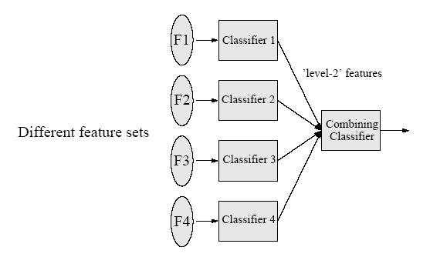
Architecture

Slide 9
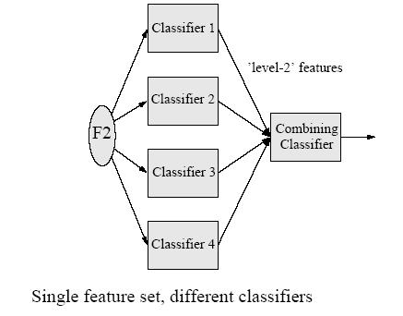
Architecture

Slide 10
Bagging
Instead of designing multiple classifiers with the same dataset, we can manipulate the training set: multiple training sets are created by re-sampling the original data according to some distribution. E.g., bagging and boosting
Bagging
Derived from bootstrap (Efron, 1993)
Create classifiers using training sets that are bootstrapped (drawn with replacement)
Average results for each case

Slide 11
Bagging Example
Original | 1 | 2 | 3 | 4 | 5 | 6 | 7 | 8
Training set 1 | 2 | 7 | 8 | 3 | 7 | 6 | 3 | 1
Training set 2 | 7 | 8 | 5 | 6 | 4 | 2 | 7 | 1
Training set 3 | 3 | 6 | 2 | 7 | 5 | 6 | 2 | 2
Training set 4 | 4 | 5 | 1 | 4 | 6 | 4 | 3 | 8

Slide 12
Bagging
Sampling (with replacement) according to a uniform probability distribution
Each bootstrap sample D has the same size as the original data.
Some instances could appear several times in the same training set, while others may be omitted.
Build classifier on each bootstrap sample D
D will contain approximately 63% of the original data.
Each data object has probability 1- (1 – 1/n)^{n} of being selected in D

Slide 13
Bagging
Bagging improves generalization performance by reducing variance of the base classifiers. The performance of bagging depends on the stability of the base classifier
If a base classifier is unstable (high variance), bagging helps to reduce the errors associated with random fluctuations in the training data
If a base classifier is stable, bagging may not be able to improve, rather it could degrade the performance
Bagging is less susceptible to model over fitting when applied to noisy data

Slide 14
Boosting
Sequential production of classifiers
Each classifier is dependent on the previous one, and focuses on the previous one’s errors
Examples that are incorrectly predicted in previous classifiers are chosen more often or weighted more heavily

Slide 15
Ada-Boosting
Records that are wrongly classified will have their weights increased
Records that are classified correctly will have their weights decreased
Boosting algorithms differ in terms of (1) how the weights of the training examples are updated at the end of each round, and (2) how the predictions made by each classifier are combined
Example 4 is hard to classify
Its weight is increased, therefore it is more likely to be chosen again in subsequent rounds

Slide 16
Ada-Boosting
Complex hypotheses tend to over fitting
Simple hypotheses may not explain data well
Combine many simple hypotheses into a complex one
Ways to design simple ones, and combination issues

Slide 17
Ada-Boosting
Two approaches
Select examples according to error in previous classifier (more representatives of misclassified cases are selected) – more common
Weigh errors of the misclassified cases higher (all cases are incorporated, but weights are different) – does not work for some algorithms

Slide 18
Boosting Example
Original | 1 | 2 | 3 | 4 | 5 | 6 | 7 | 8
Training set 1 | 2 | 7 | 8 | 3 | 7 | 6 | 3 | 1
Training set 2 | 1 | 4 | 5 | 4 | 1 | 5 | 6 | 4
Training set 3 | 7 | 1 | 5 | 8 | 1 | 8 | 1 | 4
Training set 4 | 1 | 1 | 6 | 1 | 1 | 3 | 1 | 5

Slide 19
Ada-Boosting
Input:
Training samples S = {(x_{i}, y_{i})}, i = 1, 2, …, N
Weak learner h
Initialization
Each sample has equal weight w_{i} = 1/N
For k = 1 … T
Train weak learner h_{k} according to weighted sample sets
Compute classification errors
Update sample weights w_{i}
Output
Final model which is a linear combination of h_{k}

Slide 20
Ada-Boosting

Slide 21
Ada-Boosting

Slide 22
Ada-Boosting

Slide 23
Ada-Boosting

Slide 24
Ada-Boosting

Slide 25
Ada-Boosting

Slide 26
Imp Notes
Weak learner: error rate is only slightly better than random guessing
Boosting: sequentially apply the weak learner to repeated modified version of the data, thereby producing a sequence of weak classifiers h(x). The prediction from all of the weak classifiers are combined through a weighted majority vote
H(x) = sign[sum(a_{i}h_{i}(x))]

Slide 27
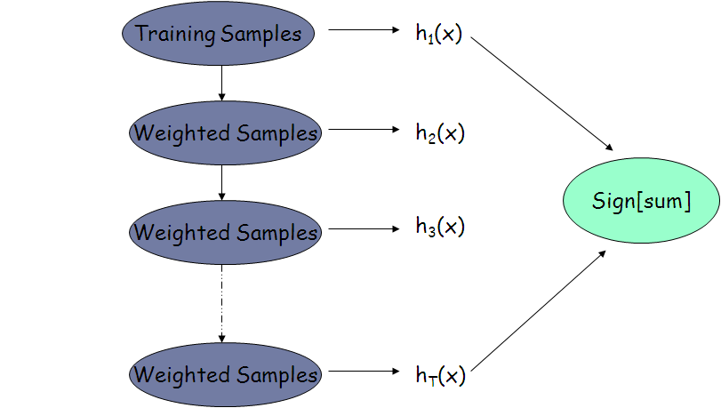
Schematics

Slide 28
Calculations
For k = 1 to T
Fit a learner to the training data using weights w_{i}
Compute
Set w_{i}
Final Outcome

Slide 29
Ada-Boosting
It penalizes models that have poor accuracy
If any intermediate rounds produce error rate higher than 50%, the weights are reverted back to 1/n and the re-sampling procedure is repeated
because of its tendency to focus on training examples that are wrongly classified, the boosting technique can be quite susceptible to overfiting
However, in practice it is seen that the boosted trees are quite robust to overfiting due to averaging

